Slide 1

uXML
Universal Intermediate Language
Kunal S. Pathak

Slide 2

Outline
Background - UNCOL
What is uXML?
Motivation behind uXML
Applications of uXML
Features of uXML tool
Q&A

Slide 3
Keywords
Programming language
Life cycle of a program
XML – Extensible Markup Language
Source
code
Front-end
Intermediate
code
Back-end
Machine
code
Compiler

Slide 4
Before UNCOL
Program in
language A
Output
Machine 1
Program in
language B
Output
Machine 2
Program in
language C
Output
Machine 3
Program in
language D
Output
Machine 4

Slide 5
After UNCOL
Program in
language A
U
N
C
O
L
Output
Machine 1
Program in
language B
Output
Machine 2
Program in
language C
Output
Machine 3
Program in
language D
Output
Machine 4

Slide 6
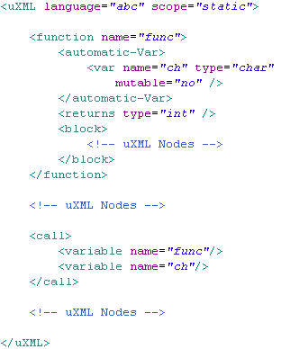
uXML
Front
end
uXML
Back end
Program in
C
Program in
Pascal
xv tool
Program Output
Program in
Java
Program in
Lisp

Slide 7
Motivation behind uXML
A common representation of disparate languages
Source program in a tree structured format
Powerful XML processing tools available
Experiment on programs written in XML

Slide 8
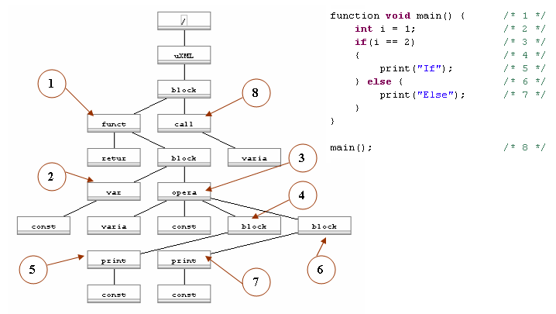
Sample C-like program

Slide 9
Applications of uXML
Source code analysis
  Software Metrics
Educational purpose
  Plug-and-play front-end
Programming language converter
  A => uXML => B

Slide 10
Features of uXML tool
Grammar of uXML language
  User Manual
4 language processors
  C-like, Pascal-like, Java-like, Lisp-like
  Source-code => uXML
1 uXML language processor
  uXML => Output
Compiler framework

Slide 11
UNCOL to uXML
UNCOL
Different front-ends and a common backend
Portability of languages on different computer architecture
Execute programs in different PLs on different machines
uXML
Different front-ends and a common backend
Portability of language’s structure in a universal format
Analyze programs in different PLs with a common tool

Slide 12
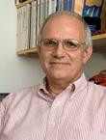
uXML Advisors
Prof. James Heliotis
  Languages and Tools
  www.cs.rit.edu/~jeh

Slide 13
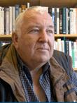
uXML Advisors
Prof. James Heliotis
  Languages and Tools
  www.cs.rit.edu/~jeh
Prof. Axel Schreiner
  Language Processing,
  Parser Generator
  www.cs.rit.edu/~ats

Slide 14
Questions?

Slide 15
Thank You!!

